Slide 1



G H RAISONI COLLEGE OF ENGINEERING AND MANAGEMENT
(Approved by AICTE, New Delhi and Recognized by DTE, Maharashtra)
An Autonomous Institute Affiliated to Rashtrasant Tukadoji Maharaj Nagpur University, Nagpur
Accredited by NAAC with A+ Grade
Department of Computer Science & Engineering (Cyber Security)
Introductory Project Seminar
(B. Tech 7ᵗʰ Semester)
On
SoulPass - Soulbound NFT Based Certification System
Guide
Prof. Shalini Kumari
Assistant Prof. Department Of CSE (Cyber Security)
Name Of Projectee’s
Varun Gotmare
Tejashwini Battinwar
Vaishnavi Lepande
Shruti Singh Thakur
Siddhant Sakhare
Session 2025-2026

Slide 2
Contents
Introduction
Literature Survey
Problem Statement
Justifications for Selecting the Title
Objectives of the Project
Block Diagram
Expected Result
Work plan
References

Slide 3

Introduction
SoulPass (Soulbound NFT Based Certification System)
SoulPass introduces a decentralized solution using soulbound NFTs
Issues non-transferable digital certificates for events like seminars and hackathons.
Credentials are securely tied to the student’s wallet on the blockchain.
Uses QR codes for easy NFT claiming during events.
Ensures authenticity, prevents duplication, and builds a verifiable academic record.
Built on Ethereum, it uses smart contracts, wallet-based identity, and IPFS storage.
Not Just a Pass, It’s Soul-bound

Slide 4
Literature Survey
Sr. No. | Paper Title and its Author | Details of Publication | Findings
1 | Digital credentials management system using rejectable soulbound tokens - Rosa Pericàs-Gornals | Annals of Telecommunications. Pericàs-Gornals, R., Mut-Puigserver, M., Payeras-Capellá, M. M., Cabot-Nadal, M. Á., & Ramis-Bibiloni, J. | Proposed the use of rejectable soulbound tokens (RejSBTs) to provide user-controlled credential acceptance, non-repudiation, and privacy-friendly metadata management in credentialing systems.
2 | Blockchain for Education: Lifelong Learning Passport -Wolfgang Gräther | European Society for Socially Embedded Technologies (EUSSET) Gräther, W., Kolvenbach, S., Ruland, R., Schütte, J., Torres, C., & Wendland, F | Proposed a lifelong blockchain-based learning record, enabling individuals to securely store and share educational achievements across institutions
3 | Exploring User Acceptance of Blockchain-Based Student Certificate Sharing System - Prakhyat Khati | Blockchain and Applications, 6th International Congress Khati, P., Shrestha, A. K., & Vassileva, J. (2025). | Studied user behavior and acceptance towards blockchain credentials, highlighting trust, usability, and institutional control as key factors.
4 | SoulBound E-Voting System - Aayush Sagar, Dr. Sudha Narang, | International Journal For Research In Applied Science And Engineering Technology A. Seth, A., Narang, S., Sagar, A., & Jain, S. (2023). | Demonstrates how SBTs can provide tamper-proof, non-transferable voter identities for secure digital elections—proves security and integrity of one-person-one-vote systems.

Slide 5





Problem Statement
Traditional and digital certificate systems used by event organizers and institutions are often inefficient, easy to forge, and lack a standard method for verification. These systems do not provide permanent ownership, transparency, or tamper-proof validation. As a result, both students and admins struggle with authenticity, manual verification, and record-keeping.
Challenges:
🔹 For Admins:
Risk of Forgery
No Secure Verification
🔹 For Students:
Loss or Damaged Certificates
No Authenticity Proof

Slide 6
Justifications for Selecting the Title
Justifications for Selecting the Title
Existing digital credential systems are prone to forgery, loss, and centralization risks.
No enforcement of non-transferability in traditional certificate systems
Need for decentralized, tamper-proof, and identity-bound credentialing.
Soulbound NFTs provide cryptographic ownership and integrity.
Aligns with cybersecurity goals: authentication, access control, and non-repudiation.
Rising need in educational institutions for scalable, secure certificate management.

Slide 7
Objectives of the Project
Objectives Of The Project
Build a tamper-proof, decentralized credential verification system
Leverage Soulbound NFTs to eliminate fraud and forgery in certification
Enforce non-transferability and immutability of credentials
Secure student identity using blockchain-based authentication
Replace traditional certificate systems with cryptographically signed tokens
Prevent impersonation and unauthorized claims using zero-trust principles
Enable transparent, verifiable credential audits without third-party trust

Slide 8
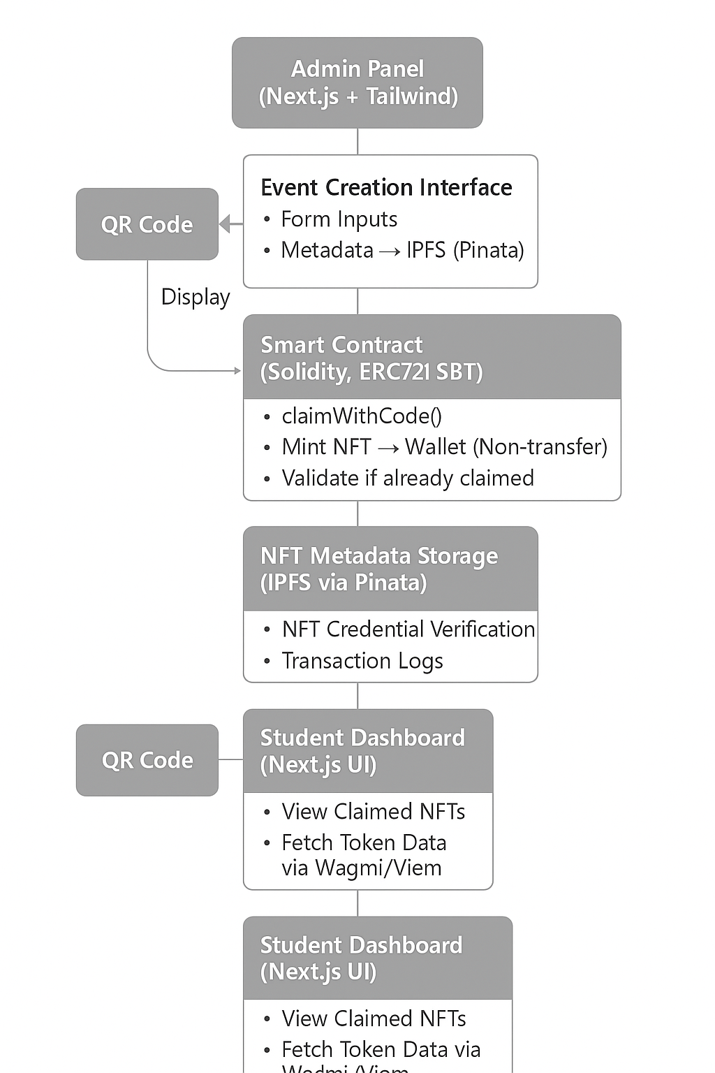
Block Diagram

Slide 9
Expected Result
Expected output of the project
1. Seamless Credential Issuance
•Admins create events → students scan QR codes → soulbound NFTs minted instantly to wallets
•~90% reduction in manual attendance tracking effort
2. Immutable & Verifiable Credentials
•Credentials become non-transferable, cryptographically secure NFTs, permanently tied to identity
•On‑chain verification replaces slow manual checks, eliminating fraud (e.g., diploma forgery)
3. Student-Centric Academic Profile
•Personalized on‑chain dashboards display student event histories and achievements
•Enables lifelong learning portfolios across courses and certifications
4. Enhanced Trust & Reputation
•Stronger trust in credentials; non-transferability prevents impersonation and document misuse
•Aligns with global trends showing reduced fraud and increased employer confidence
5. Scalable & Extensible System
•Designed for expansion: workshop events → online courses → degree issuance → professional certifications
•Leverages soulbound NFT model from broader academic credential use cases

Slide 10
Work – Plan
Months Activities | JUN’25 | JULY’25 | AUG’25 | SEPT’25 | OCT’25
Literature Reviews | √
Component Identification & Selection |  | √
Designing
Fabrication
Experimental Analysis
Testing and Debugging
Preparation of Project Report
Thesis and Poster Submission

Slide 11
References
List of papers/books/websites etc refer for project
Research Papers:
Ohlhaver, P., Weyl, E. G., & Buterin, V. (2022). Decentralized society: Finding web3's soul. Available at SSRN 4105763.
Goldston, J., Chaffer, T. J., Osowska, J., & von Goins Ii, C. (2023). Digital inheritance in Web3: a case study of soulbound tokens and the social recovery pallet within the Polkadot and Kusama ecosystems.
IBM Blockchain Whitepaper. (2021). Blockchain for Credential Verification. https://www.ibm.com/downloads/cas/6D5PMLZB
Websites:
OpenZeppelin. (2023). ERC721 & Soulbound Token Standards. https://docs.openzeppelin.com/contracts/
Ethereum Foundation. (2023). Ethereum Smart Contracts & Gas Optimization. https://ethereum.org/
5Pinata. (2024). IPFS & Metadata Storage for NFTs. https://www.pinata.cloud/
Alchemy Docs. (2024). Implementing Gasless Transactions Using Meta Transactions. https://docs.alchemy.com/
EIP-721: Non-Fungible Token Standard. https://eips.ethereum.org/EIPS/eip-721
Ethereum Improvement Proposals (EIPs). (2022). Soulbound Token Drafts. https://github.com/ethereum/EIPs/issues/5114
WAGMI & Viem Documentation. (2024). Web3 Frontend Toolkit for React. https://wagmi.sh

Slide 12
References
List of papers/books/websites etc refer for project
GitHub - Soulbound Token Projects. (2023). https://github.com/topics/soulbound-token
Khan Academy. Introduction to Blockchain and NFTs. https://www.khanacademy.org/
Medium Blogs: Soulbound Tokens and Cybersecurity Implications. https://medium.com/tag/soulbound-tokens
Credly. (2024). Digital Badging Platform Overview. https://www.credly.com

Slide 13

Thank you!
Nagpur | Pune | Jalgaon | Amravati | Pandhurna | Bhandara

